Slide 1
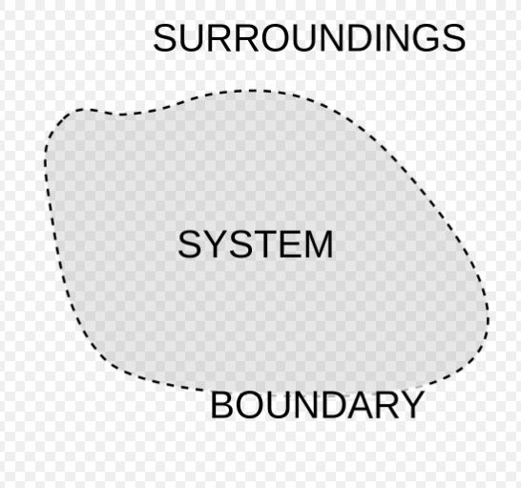
System Properties
Distinguishing characteristics of a system.
Macroscopic description of a system.
Either directly or indirectly observable
Collection of matter
(physical or imaginary)
Exchange of Heat and Work while material interacts with surrounding.

Slide 2
HEAT or WORK both are energy in TRANSIT.
Once they cross the system boundary, they disappear
&
become the part of ENERGY of the system.

Slide 3
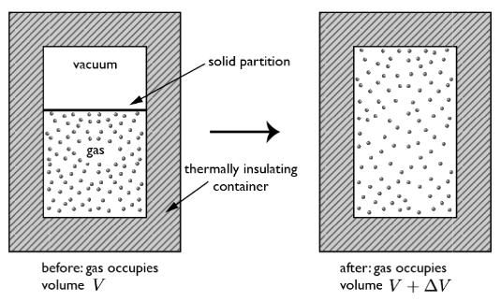
Thermodynamic Work done in Free Expansion is ZERO.
It is an Irreversible process
(can be understood only in terms of ENTROPY generation)

Slide 4

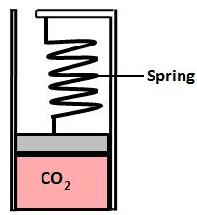
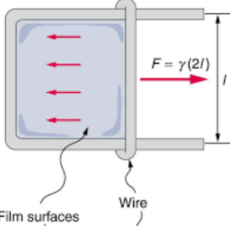
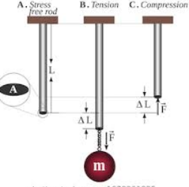
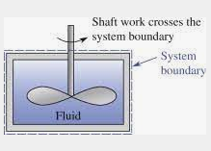
WORK (THERMODYNAMIC) INTERACTIONS
Any energy transfer which is not heat, it must be WORK.
Mechanical work:
System boundary movement by excess force (system ̶ surrounding)
(*There must be a opposing force)
Example: Work done by excess pressure on piston
Work done by elastic/restoring forces, such as spring force, elastic force in solid, surface tension force in liquid thin films.
Shaft work

Slide 5
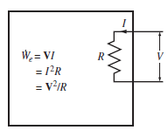
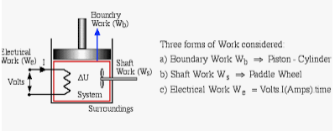
WORK INTERACTIONS
Non-Mechanical work:
Electrical work
Magnetic Work
HEAT or WORK? (depends on the choice of the system)

Slide 6
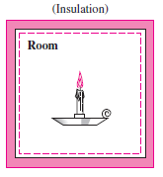
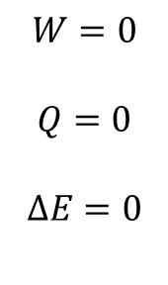
Burning of a Candle in an Insulated Room
System Boundary

Slide 7
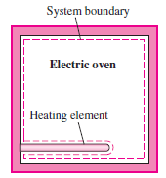
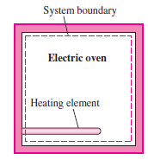
Heating of an Oven by Work Transfer
Heating of an Oven by Heat Transfer

Slide 8
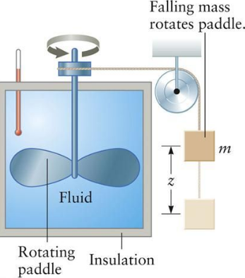
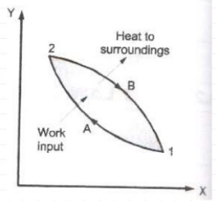



Joule’s Experiment (1848)
There exists for every thermodynamic system a property called the energy. The change of energy of a system is proportional to the mechanical work done on the system in an adiabatic process.

Slide 9
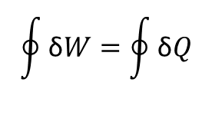
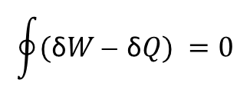


General version of Joule’s statement:
There exists for every thermodynamic system a property called the energy (E). The change of energy of a system is proportional to the mechanical work done on the system in an adiabatic process.

Slide 10
Thermodynamic Work = Generalized force (intensive variable) × displacement
(extensive variable)
Mechanical Work = pressure × volume
Stretching Work = surface tension × length
Electrical Work = Voltage × charge

Slide 11
Thermodynamic Properties
The distinguishing characteristics of a system, basically quantities needed
to specify a Macroscopic Description/State of System completely.
Either directly or indirectly measurable
Change is independent, hence can be written as exact differential.

Slide 12
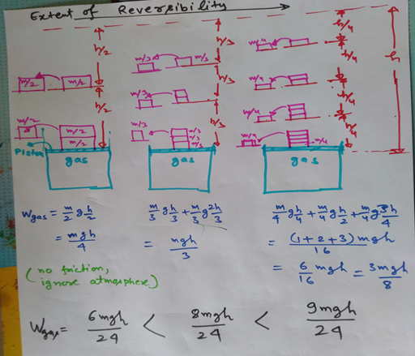
Internally Reversible Process (quasi static process)

Slide 13
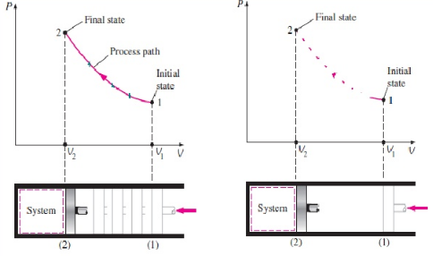
Quasi-static process
At every instant System departs only infinitesimally from Equilibrium state.
Quasi-static process
Non Quasi-static process

Slide 14
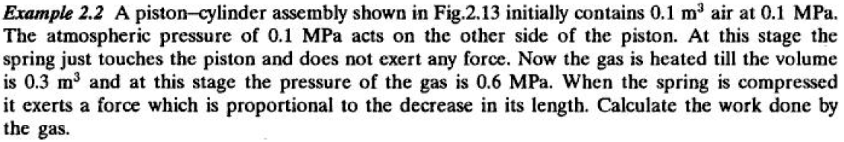
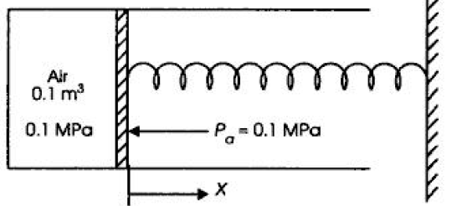



(CET, YVC Rao)

Slide 15
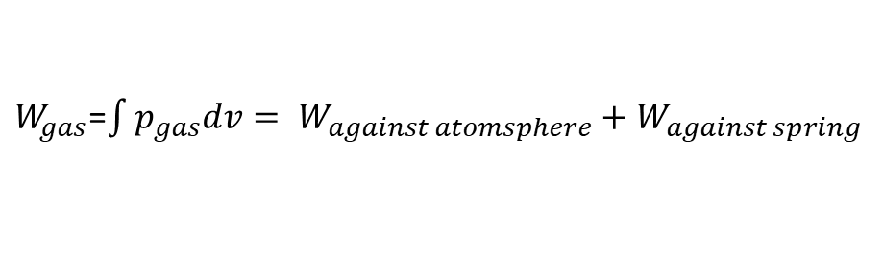

Mechanical equilibrium at each point, net force on piston is zero at any instant.

Slide 16
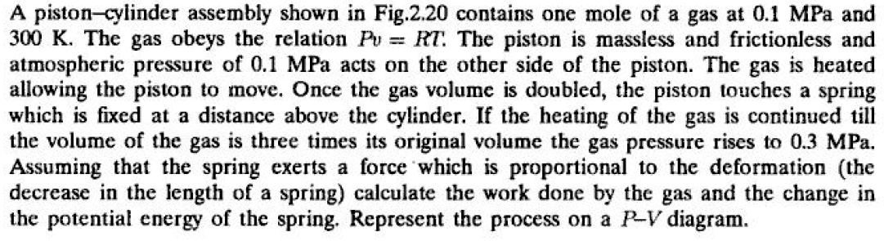
(CET, YVC Rao)
Ex. 2.13

Slide 17
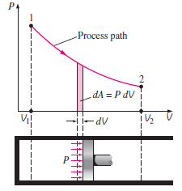

Slide 18
A reversible process :
- reversible both internally and externally, When reversed, retraces its forward path, and restores the initial state of system and surroundings - Is frictionless - Is never more than differentially removed from equilibrium - Traverses a succession of equilibrium states - Is driven by forces whose imbalance is differential in magnitude - Can be reversed at any point by a differential change in external conditions

